Slide 1
Probabilistic Modelling of Indoor Geometry to Generate Synthetic Datasets for Scene Understanding
MTP- II, Spring 2019-20
Submitted By: Aravind R (15EE35014)
Under the Supervision of: Dr. Sk Mohammadul Haque

Slide 2
Motivation
There is a need for enormous quantities of labelled data, performance increases in proportion to the amount of data used
Missing labels and mislabelled frames are very common in many real data sets
Introducing a synthetic data set would mean unlimited training data and improved semantic labelling
We aim to build a probabilistic framework for placing objects in a 2D scene
This could be used to generate large scale physically appropriate synthetic data sets for scene understanding

Slide 3
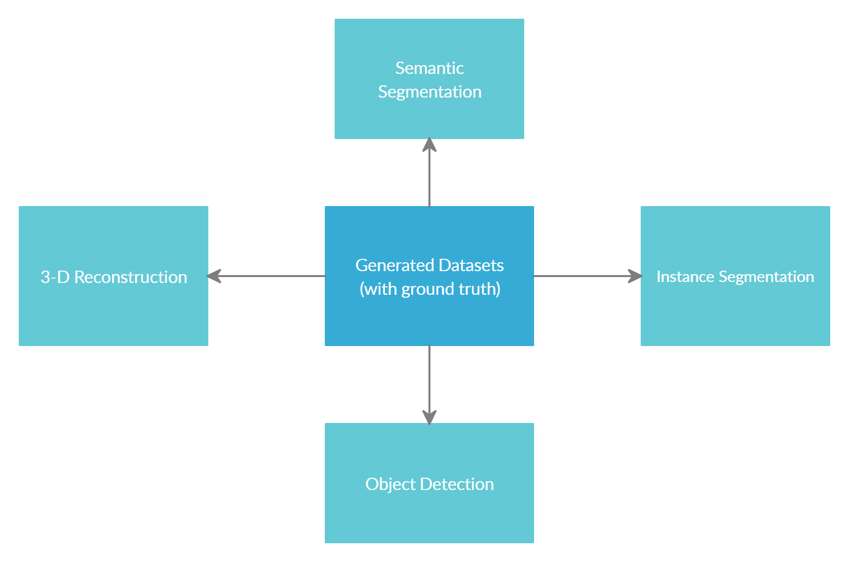
Applications

Slide 4
Method
We formulate automatic object placement from individual objects as an energy optimisation problem
The weighted sum of different constraints is minimised via simulated annealing
We have used this simulated annealing algorithm for placing objects in a 2D indoor setting
Used different constraints like bounding box intersection, pairwise distances, visibility as well as distance and angle with the wall

Slide 5
Method
The object models considered were Circular, Rectangular and a Mixed model
Their performance(running time) was tested for varying number of objects, classes of the objects and size of the room.
We Render 3-D indoor scenes generated with the optimized positions and orientations obtained through the simulated annealing algorithm

Slide 6
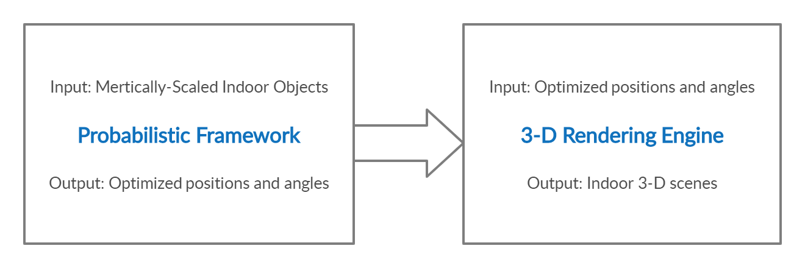
Pipeline

Slide 7
Automatic Object Placement using Simulated
Annealing
Energy optimization problem which uses the following constraints and minimizes the overall energy function using the simulated annealing algorithm.
The constraints considered are:
Bounding Box Intersection: objects bounding boxes should not intersect with each other.
Pairwise distances: Some classes of objects are more likely to occur near other classes of objects in real scenes like nightstands near beds, chairs next to tables
Visibility constraint: Objects should be fully visible from each other through the line joining their centres. For eg: television being visible from the sofa
Distance and angle with Wall:Many objects observed in real world scenes are usually against the wall and are aligned with the wall.

Slide 8
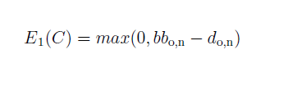
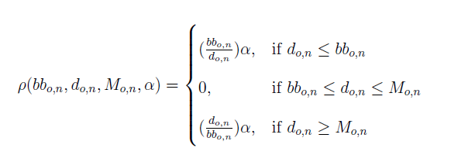
Constraints and Energy Functions
Bounding Box Intersection:
Pairwise Distances:

Slide 9
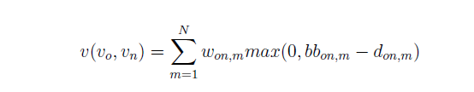


Constraints and Energy Functions
Visibility Constraint:
Distance with Wall:
Angle with Wall:

Slide 10
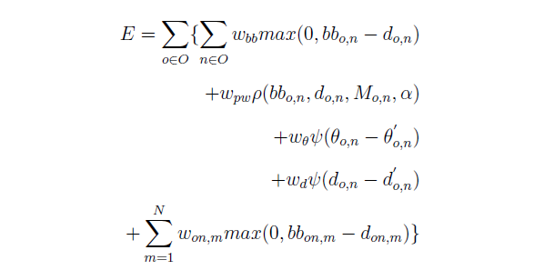
Constraints and Energy Functions
The overall energy function is a weighted sum of the different constraints:

Slide 11
Simulated Annealing Algorithm
The Simulated Annealing algorithm is used in our problem for minimizing the overall energy function
We thus find optimized orientations and positions for the objects for placing the objects in a 2-D scene
The method resembles the physical process of heating a material and lowering the temperature slowly to decrease the defects in the material
As the temperature reaches a minimum, the system energy is minimized and defects are corrected

Slide 12
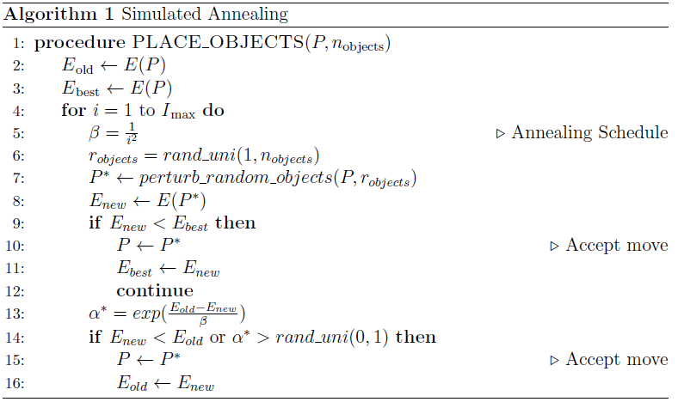
Simulated Annealing Algorithm

Slide 13
Experiments
We have generated 2-D top views of a rectangular room by placing the projected 2-D objects based on the optimized position and angles obtained
The 2-D top views were generated for different types of object models viz. Rectangular, Circular and a Mixed object model.
For generating the 2-D top view we have used simulated annealing with random perturbation of 5 objects for each step in the algorithm
The algorithm was tested for varying number of classes, objects and room sizes using random initialization of the objects and 2000 iterations of the algorithm.

Slide 14
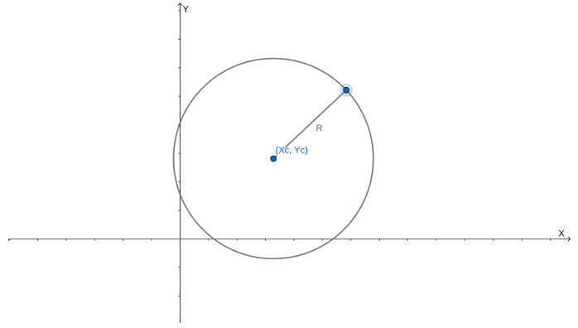
Circular Object Model
We start with a very simplistic model for the objects by modelling them as circle
Some circular shaped objects observed in real world indoor scenes include dining tables, sofas, bathtubs etc

Slide 15
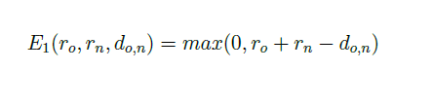
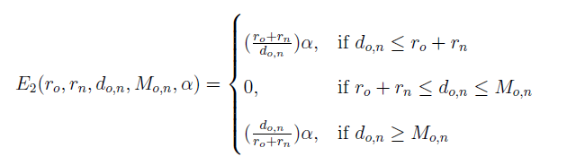
Modified Energy Functions
Bounding-Box Intersection:
Pairwise Distances:

Slide 16
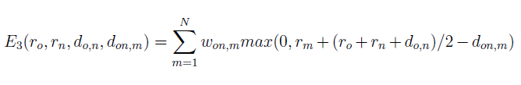
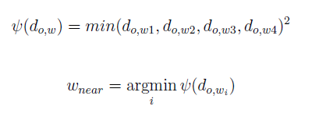

Modified Energy Functions
Visibility Constraint:
Distance with Wall:
Angle with Wall:

Slide 17
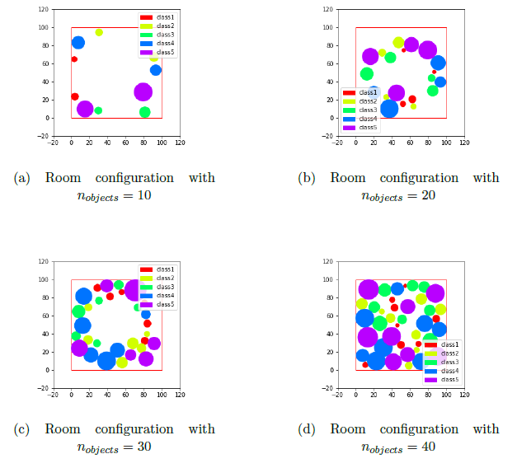
2-D top views (Varying Objects)

Slide 18
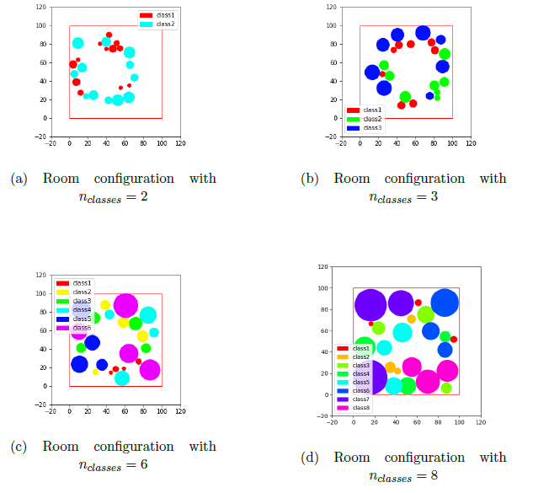
2-D top views (Varying Classes)

Slide 19
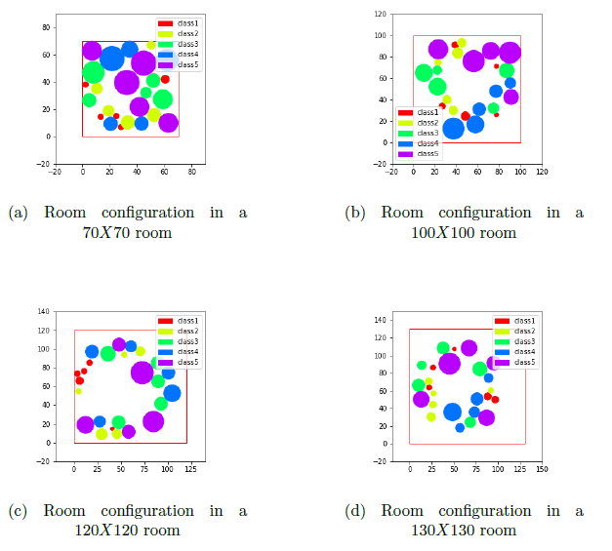
2-D top views (Varying Room Size)

Slide 20
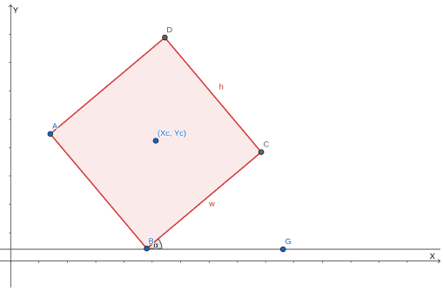
Rectangular Object Model
We try to generalize further by modelling objects as rectangles
Most objects observed in real world indoor scenes like tables, desks, beds, cupboards all seem to have a rectangular shape

Slide 21
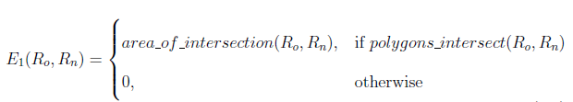
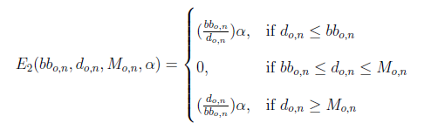
Modified Energy Functions
Bounding-Box Intersection:
Pairwise Distances:

Slide 22

Modified Energy Functions
Visibility Constraint:
Distance with Wall:
Angle with Wall:

Slide 23
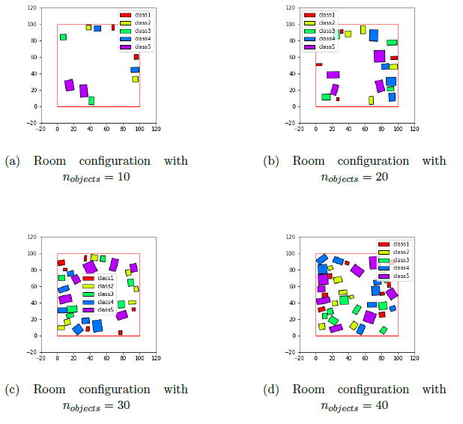
2-D top views (Varying Objects)

Slide 24
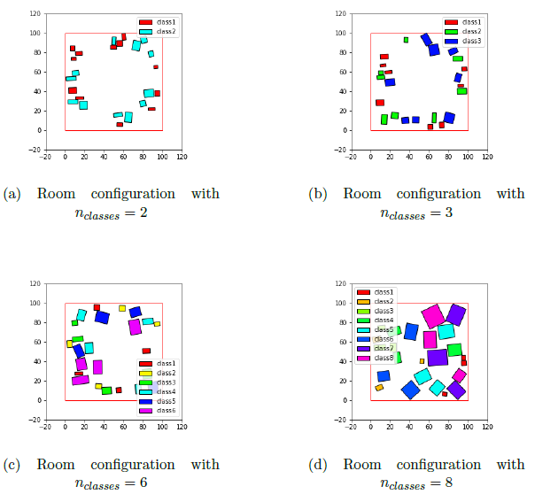
2-D top views (Varying Classes)

Slide 25
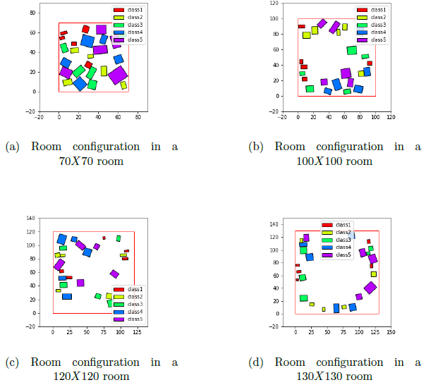
2-D top views (Varying Room Size)

Slide 26
Mixed Object Model
To properly generalize our model further, we include both Rectangular as well as Circular objects
Real life objects of different shapes can be modelled efficiently when projected on to the 2-D plane.
We further modify the energy functions based on the type(Circular or Rectangular) of the object.

Slide 27
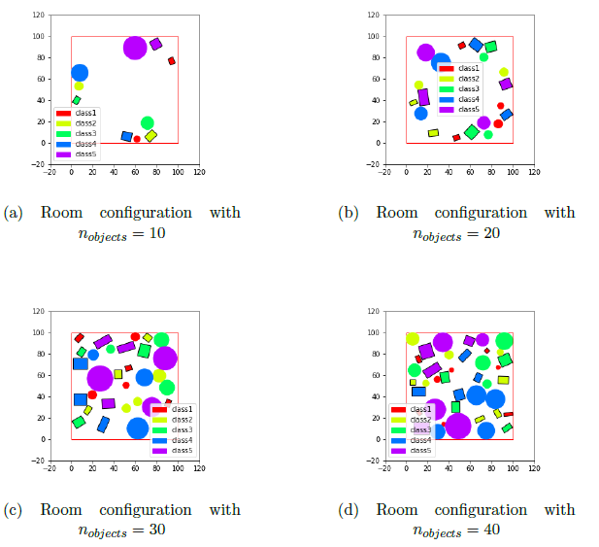
2-D top views (Varying Objects)

Slide 28
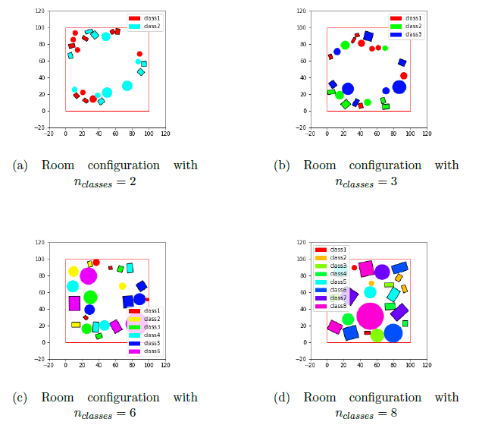
2-D top views (Varying Classes)

Slide 29
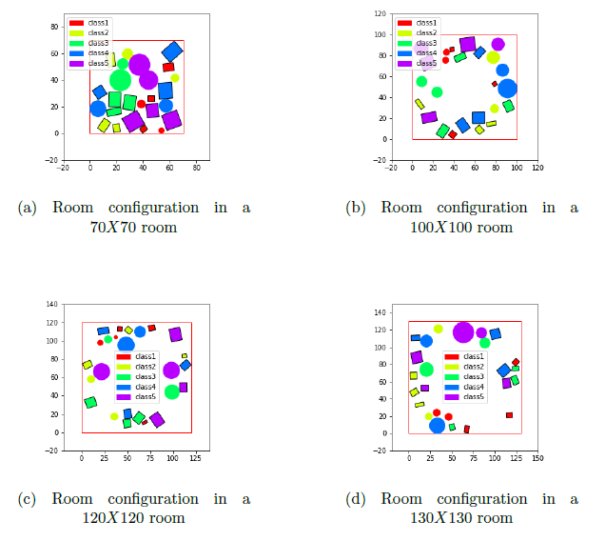
2-D top views (Varying Room Size)

Slide 30
Running Time Analysis
We have measured the running time for all the three object models viz. Rectangular, Circular and Mixed models
We have taken the average run-time of the Simulated Annealing algorithm for 50 trials each of every room configuration
We used random initializations for positions and angles of the objects and have plotted the run time with varying number of objects, classes as well as the size of the room.

Slide 31
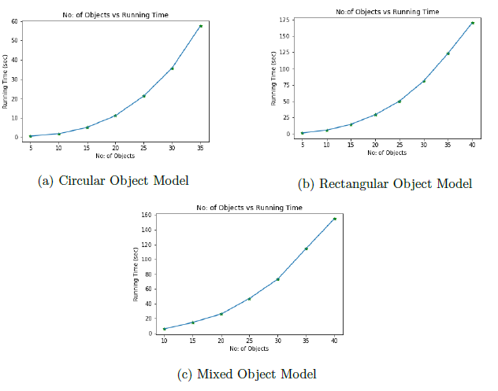
Running Time Analysis(Varying Objects)

Slide 32
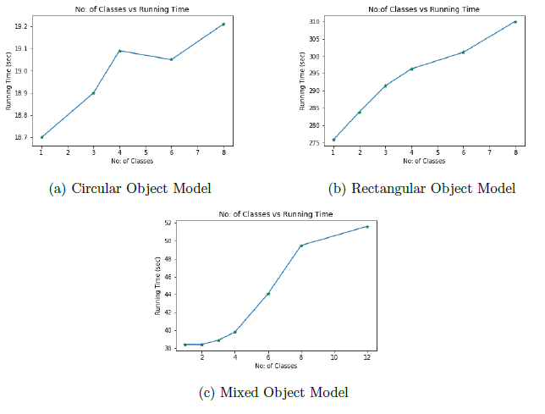
Running Time Analysis(Varying Classes)

Slide 33
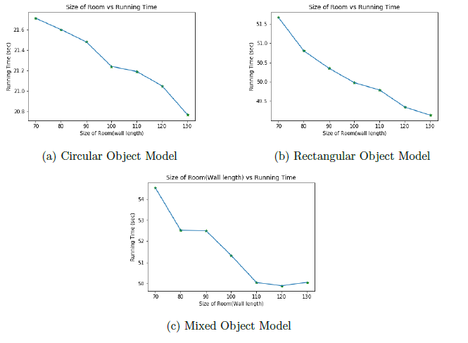
Running Time Analysis(Varying Room Size)

Slide 34
3-D Renderings
We have generated 3-D indoor scenes from the obtained optimized congurations i.e the positions and orientations of the objects
We have used classes observed in real scenes and have rendered them using an open-source 3-D rendering software called “Sweet Home 3-D”
We have considered four classes for generating these 3-D views i.e Bed, Chair, Cupboard and Table
We have considered ten such objects which include one bed, five chairs,two tables and two cupboards in order to render a realistic bedroom scene.

Slide 35
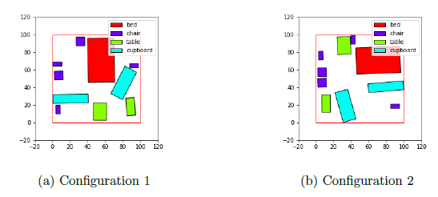
3-D Renderings
The 2-D top views generated for two configurations are shown below:

Slide 36
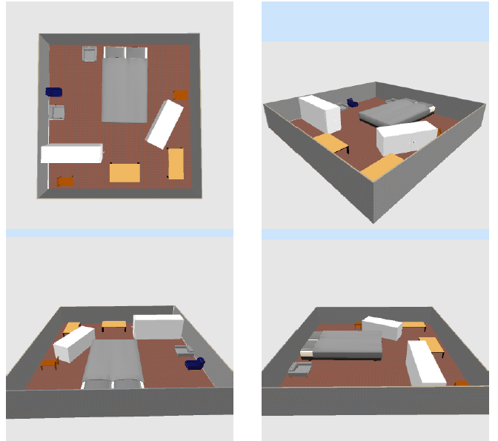
3-D Rendering of Configuration 1

Slide 37
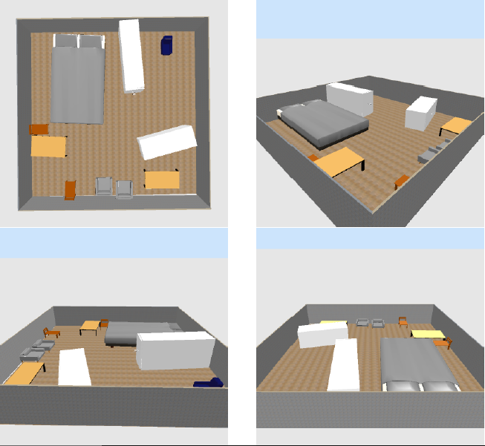
3-D Rendering of Configuration 2

Slide 38
Conclusion
We have implemented and studied a probabilistic framework for placing objects in a 2D scene by optimising the positions and angles of objects using simulated annealing
We have worked with different object models (Rectangular,Circular and Mixed)
We have generated the 2-D top views from the optimized positions and angles and have done a run time analysis of the same
We have also generated optimized 3-D indoor scenes using realistic classes with the help of “Sweet Home 3-D” software

Slide 39
Future Work
The current solution for 3D scene generation can work with any sophisticated rendering engine to generate more realistic renderings
The number of configuration parameters and constraints can possibly be increased to model more complex geometric configurations
The framework can be used to model a wider variety of natural datasets and not just indoor scenes
The framework can be tested through a number of applications such as Semantic Segmentation, Instance Segmentation and object detection
The implementation of hierarchical clustering within the framework would group similar objects type and thus give less cluttered rooms

Slide 40
References
Sweet Home 3-D https://sourceforge.net/projects/sweethome3d/
J. McCormac, A. Handa, S. Leutenegger, and A. J. Davison. Scenenet rgb-d:Can 5m synthetic images beat generic imagenet pre-training on indoor segmentation? In 2017 IEEE International Conference on Computer Vision (ICCV),pages 2697-2706, 2017.
A. Handa, V. Patraucean, S. Stent, and R. Cipolla. Scenenet: An annotated model generator for indoor scene understanding. In 2016 IEEE International Conference on Robotics and Automation (ICRA), pages 5737-5743, 2016.

